Slide 2
Access Modifiers in Java
The access modifiers in Java specifies the accessibility or scope of a field, method, constructor, or class.
We can change the access level of fields, constructors, methods, and class by applying the access modifier on it.

Slide 3


Slide 4
Access Modifiers in Java
There are four types of Java access modifiers:
Private: The access level of a private modifier is only within the class. It cannot be accessed from outside the class.
Default: The access level of a default modifier is only within the package. It cannot be accessed from outside the package. If you do not specify any access level, it will be the default.
Protected: The access level of a protected modifier is within the package and outside the package through child class. If you do not make the child class, it cannot be accessed from outside the package.
Public: The access level of a public modifier is everywhere. It can be accessed from within the class, outside the class, within the package and outside the package.

Slide 5
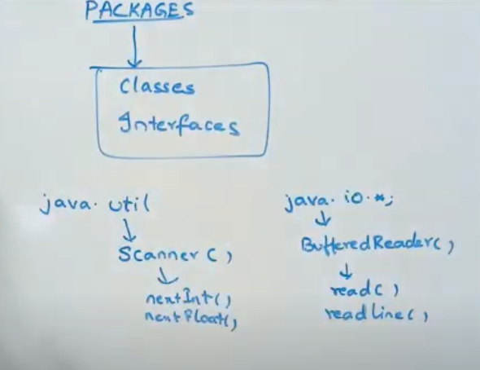

Slide 6
Access Modifier | within class | within package | outside package by subclass only | outside package
Private | Y | N | N | N
Default | Y | Y | N | N
Protected | Y | Y | Y | N
Public | Y | Y | Y | Y

Slide 7
1) Private Access Modifiers
The private access modifier is accessible only within the class.

Slide 8
class A{
private int data=40;
private void msg(){
System.out.println("Hello java");}
}
public class Simple{
public static void main(String args[]){
A obj=new A();
System.out.println(obj.data); //Compile Time Error
obj.msg(); //Compile Time Error
}
}

Slide 9
In this example, we have created two classes A and Simple. A class contains private data member and private method. We are accessing these private members from outside the class, so there is a compile-time error.

Slide 10
2) Default Access Modifiers
If you don't use any modifier, it is treated as default by default. The default modifier is accessible only within package. It cannot be accessed from outside the package. It provides more accessibility than private. But, it is more restrictive than protected, and public.

Slide 11
//save by A.java
package pack;
class A
{
void msg()
{
System.out.println("Hello");
}
}

Slide 12
//save by B.java
package mypack;
import pack.*;
class B{
public static void main(String args[]){
A obj = new A(); //Compile Time Error
obj.msg(); //Compile Time Error
}
}

Slide 13
Example of default access modifier
In this example, we have created two packages pack and mypack. We are accessing the A class from outside its package, since A class is not public, so it cannot be accessed from outside the package.
In the above example, the scope of class A and its method msg() is default so it cannot be accessed from outside the package.

Slide 14
3) protected access modifier
The protected access modifier is accessible within package and outside the package but through inheritance only.
The protected access modifier can be applied on the data member, method and constructor. It can't be applied on the class.
It provides more accessibility than the default modifier.

Slide 15
Example of protected access modifier
//save by A.java
package pack;
public class A
{
protected void msg()
{
System.out.println(“Hello");
}
}

Slide 16
Example of protected access modifier
//save by B.java
package mypack;
import pack.*;
class B extends A{
public static void main(String args[]){
B obj = new B();
obj.msg();
}
}

Slide 17
In this example, we have created the two packages pack and mypack. The A class of pack package is public, so can be accessed from outside the package. But msg method of this package is declared as protected, so it can be accessed from outside the class only through inheritance.

Slide 18
4) Public access modifier
The public access modifier is accessible everywhere. It has the widest scope among all other modifiers.

Slide 19
Example of public access modifier
//save by A.java
package pack;
public class A{
public void msg()
{
System.out.println("Hello");
}
}

Slide 20
//save by B.java
package mypack;
import pack.*;
class B{
public static void main(String args[]){
A obj = new A();
obj.msg();
}
}

Slide 21
Access Modifier | within class | within package | outside package by subclass only | outside package
Private | Y | N | N | N
Default | Y | Y | N | N
Protected | Y | Y | Y | N
Public | Y | Y | Y | Y

Slide 22
Data Encapsulation
The process of binding code and data together in the form of a capsule
Data is wrapped in object is not accessible to functions outside the class.
Functions of the same class can access data & hence this ensures data security.

Slide 23


Slide 24
Data Encapsulation
Encapsulation is defined as the wrapping up of data under a single unit. It is the mechanism that binds together code and the data it manipulates. Other way to think about encapsulation is, it is a protective shield that prevents the data from being accessed by the code outside this shield.
Technically in encapsulation, the variables or data of a class is hidden from any other class and can be accessed only through any member function of own class in which they are declared.

Slide 25
Data Encapsulation
As in encapsulation, the data in a class is hidden from other classes using the data hiding concept which is achieved by making the members or methods of class as private and the class is exposed to the end user or the world without providing any details behind implementation using the abstraction concept, so it is also known as combination of data-hiding and abstraction..
Encapsulation can be achieved by: Declaring all the variables in the class as private and writing public methods in the class to set and get the values of variables.

Slide 26
class emp
{
int id;
}
public class sample
{
public static void main(String[] args) {
emp ob=new emp();
ob.id=100; //100
}

Slide 27
class emp
{
private int id;
}
public class sample
{
public static void main(String[] args) {
emp ob=new emp();
ob.id=10; //error
}

Slide 28
class emp
{
private int id;
public void setid(int x)
{
id=x;
}
public int getid()
{
return id;
}
}

Slide 29
public class Main
{
public static void main(String[] args) {
emp ob=new emp();
//ob.id=10;
ob.setid(10);
System.out.println("id= "+ob.getid());
//int x=ob.getid();
//System.out.println("id= "+x);
}
}

Slide 30
class emp
{
private int id;
private String name;
public void setid(int x)
{
id=x;
}
public int getid()
{
return id;
}
public void setname(String str)
{
name=str;
}
public String getname()
{
return name;
}
}

Slide 31
public class Main
{
public static void main(String[] args) {
emp ob=new emp();
ob.setid(10);
int x=ob.getid();
System.out.println("id= "+x);
ob.setname("scoe");
String st=ob.getname();
System.out.println("name= "+st);
//System.out.println("name= "+ob.getname());
}
}

Slide 32
Function overloading
Function Overloading is the ability to declare functions of the same name with different sets of parameters
C++ selects the function by examining
a) number of arguments
b) types of the argument variables
c) order of the arguments

Slide 33
Declarations
int add(int a,int b); //prototype1
int add(int a,int b, int c); //prototype2
float add(int x,float y); //prototype3
float add(float p, int q); //prototype4
float add(float x, float y); //prototype5
Function calls
cout<<add(5,10);
//uses prototype1
cout<<add(2 , 3.4);
//uses prototype3
cout<<add(2.5 , 7);
//uses prototype4
cout<<add(1.3 , 2.5)
//uses prototype5
cout<<add(1, 2, 3);
//uses prototype2

Slide 34
Function overloading
void main()
{
volume(2.5, 8);
volume(10);
volume(5.78, 72,9);
}
void volume(int a)
{
cout<<a*a*a;
} //cube
void volume(float r, int h)
{
cout<<3.14*r*r*h;
} //cylinder
void volume(float l, int b, int h)
{
cout<<l*b*h;
} //rectangular box

Slide 35
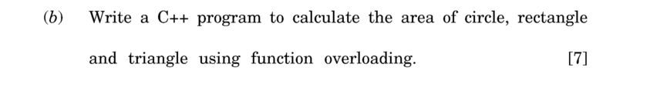

Slide 36
Class Shape
area( )
Circle object
area( circle)
triangle object
area(triangle)
rectangle object
area(rectangle)

Slide 37
int main()
{
int side, l, b;
float r,bs,ht;
cout<<"Enter side of a square:";
cin>>side;
area(side);
cout<<"Enter breadth olength and f rectangle:";
cin>>l>>b;
area(l,b);
cout<<"Enter radius of circle:";
cin>>r;
area(r);
cout<<"Enter base and height of triangle:";
cin>>bs>>ht;
area(bs,ht);
}

Slide 38
void area(int s)
{
ans=(s*s);
cout<<"Area of square is"<<ans;
}
void area(int l,int b)
{
ans=l*b;
cout<<"\nArea of rectangle is "<<ans;
}
void area(float r)
{
ans=3.14*r*r;
cout<<"\nArea of circle is "<<ans;
}
void area(float bs,float ht)
{
ans=(bs*ht)/2;
cout<<"\nArea of triangle is "<<ans;
}

Slide 39
Polymorphism
void add (int a, int b);
void add (int a, int b, int c);
void add (int x, float y);
void add (float p, int q);
void add (float x, float y);

Slide 40
void max(int x, int y)
{
if(x>y)
cout<<x<<"is greater";
else
cout<<y<<"is greater";
}
void max(float x, float y)
{
if(x>y)
cout<<x<<"is greater";
else
cout<<y<<"is greater";
}
void max(char x, char y)
{
if(x>y)
cout<<x<<"is greater";
else
cout<<y<<"is greater";
}
int main()
{
max(‘A', ‘Z');
max(3, 7);
max(44.66, 22.13);
}

Slide 41
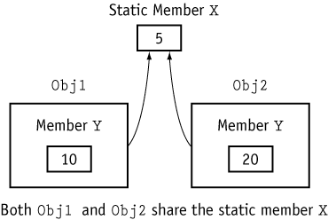
Member Variable is Static
int Y; static int X;
Roll
Name
Div

Slide 42


Slide 43
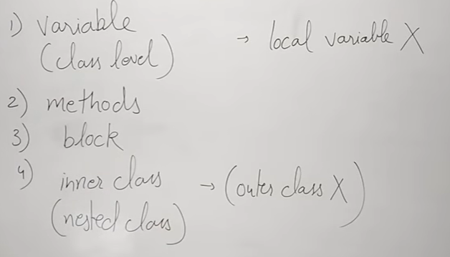

Slide 44
Contents
Constructors: Introduction, Use of Constructor, Characteristics of Constructors, Types of Constructor, Constructor Overloading, Constructor with Default Arguments, Symbolic Constants,

Slide 45
Constructor
Special member function, it is neither a value-returning function nor a void function.
There is no need to write any statement to invoke the constructor function. It is invoked when object of class is created.
It is member function of class with same name as that of a class
It is used to initialize data members of class
It does not return any value

Slide 46
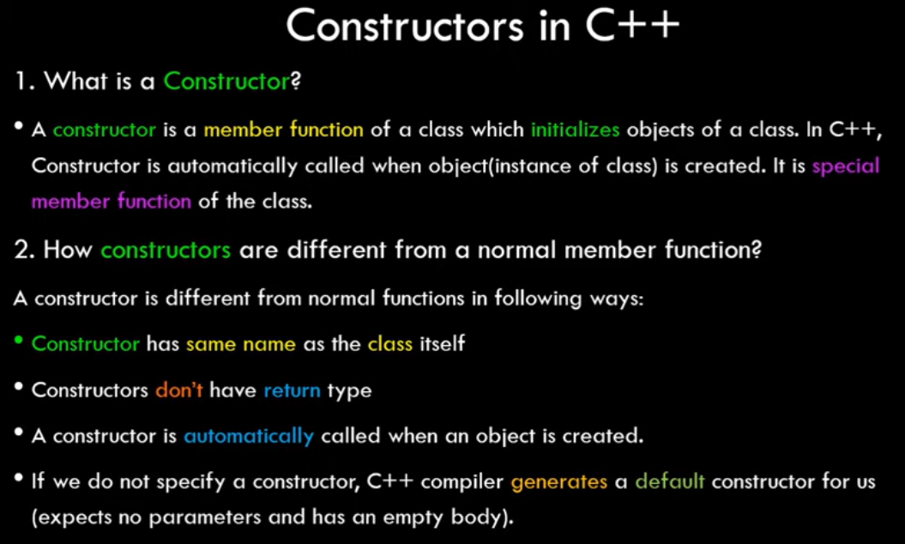

Slide 47
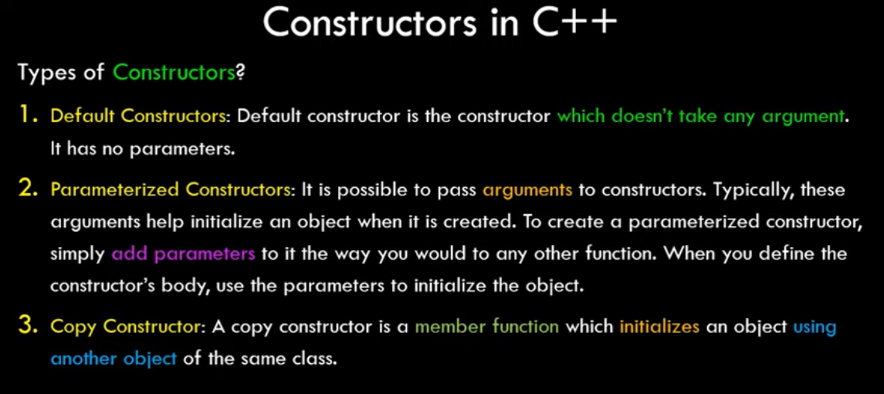

Slide 48
void add() //void return type
{
int c= a + b;
print C;
}
float add() // float return type
{
float c = a + b;
return c;
}

Slide 49
class test
{
int x, y;
test()
{
x=10;
y=20;
}
}

Slide 50
Contructors can be defined inside a class or outside the class.
It cannot be declared as static, const & virtual.

Slide 51
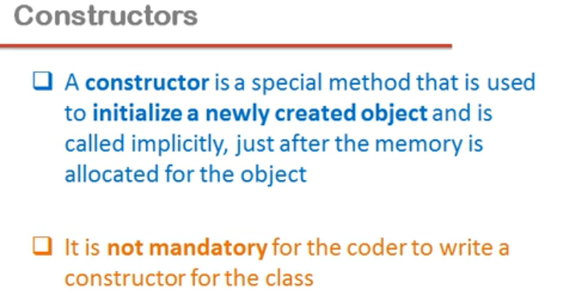

Slide 52
Compiler creates its own constructor if we don’t add any constructor in program.

Slide 53


Slide 54
Types of constructor
Default constructor
Parameterized constructor

Slide 55
Types of the Constructors
Default constructors
Default constructor is the constructor which doesn't take any argument
It has no parameter

Slide 56
2. Parameterized constructors
These are the constructors with parameters
Using this Constructor we can provide different values to data members of different objects, by passing the appropriate values as argument

Slide 57
Default constructor
class test
{
int x, y; //x=y=0
test() //initialize data members
{ x=10;
y=20;
}
}

Slide 58
Parameterized constructor
class test
{ int x,y;
test(int a, int b)
{
x=a;
y=b;
}
}

Slide 59
main()
{
test T1=new test(); //default constructor called
T1.display(); //10,20
Scanner ob=new Scanner(System.in);
X=ob.nextInt();
y=ob.nextInt();
test T2=new test(x,y); //parameterized constructor called
T2.display(); //100,200
//T1.test();
//T2.test(100,200);
}

Slide 60
class box{
int l,b,h;
box() //default constructor
{ l=10; b=20; h=30; }
box(int x, int y, int z) //parameterized constructor
{ l=x; b=y; h=z; }
void display() {
System.out.println("Length= "+l); System.out.println("Breadth= "+b); System.out.println("Height= "+h);
}
}

Slide 61
public class test{
public static void main(String[] args) {
box b1=new box(); System.out.println("Default constructor called"); b1.display();
box b2=new box(100,200,300); System.out.println("Parameterized constructor called"); b2.display();
}
}

Slide 62
Default, and Parameterized Constructors
class code
{
int id;
public:
code() {}
code(int a) {id = a;}
void display()
{
cout << id;
}
}
int main ()
{
code A (100);//parameterized
code B; // Default constructor
cout << “id of A: ”; A.display(); cout << “id of B: ”; B.display();
}

Slide 63
Overloading constructors
You can have more than one constructor in a class, as long as each has a different list of arguments.
class test
{
private:
int a,b;
public:
test(); // constructor
test(int,int); // another constructor
test(float,float); // another constructor
}

Slide 64
